Slide 1



Microsoft 365 Freelance Toolkit Tools, templates, and best practices to launch and scale an enterprise freelance program
October 2018

Slide 2

Overview
What is it?
Microsoft 365 Freelance toolkit is a solution of curated tools, templates, and best practices that help enterprises launch, execute, and manage freelance programs at scale.
Who is it for?
Enterprise customers who want to integrate freelance talent into their sourcing models.
Why is it important?
Launching and executing an enterprise freelance program at scale can be complex and daunting. The Freelance Toolkit makes it streamlined and turnkey.
IMPORTANT: Each enterprise will need to evaluate and determine its own requirements, including such things as data handling and compliance needs. Enterprises should use their existing Microsoft 365 investments as they determine appropriate based on their requirements and needs.

Slide 3
The future of work is now
To thrive in a highly competitive environment with rapidly changing technology and customer behavior, enterprises must be agile, adapting to new business models and new kinds of workers. Enter the gig economy, a labor market made up of independent workers—freelancers, consultants, contractors, solopreneurs—who contract for short-term engagements. According to Field Nation, 86% of freelancers intentionally choose freelancing.
Freelancer growth has nearly doubled each year. At this current rate, most of the U.S. workforce will be freelancers by 2027.
Millennials are a driving force of the gig economy. Nearly half of them are already freelancing.
Source: The 2016 Field Nation Freelancer Study, Field Nation, 2016 I Freelancing in America, Edelman Intelligence, 2017

Slide 4








Enterprises are embracing flexible talent
_{+24%}
Usage of flexible talent has increased 24% in the last year.
Enterprise companies have engaged freelancers for work within their organizations and integrated freelance capabilities into their own operations.
Source: 2018 Future Workforce Report, Inavero and Upwork, Feb 2018

Slide 5

Challenges for enterprises
While adding on-demand freelance talent to the mix is proving substantial, measurable results in speed and efficiency, the path to transforming existing policies and processes is largely undefined.
To be successful, enterprises must:
Change the mindset for how they approach work
Transform existing policies and processes
Develop an infrastructure that supports the complexities of an enterprise freelance program
Source: Upwork. (2018). 2018 Form S-1 Registration Statement.

Slide 6

Microsoft 365 Freelance Toolkit
“How do I roll out my program, while adhering to our company policy and compliance?”
“How do I share files & collaborate effectively with freelances in an IT-supported way?”
“How do I track the effectiveness of freelancers to convince others to sign-up?”
“How do I automatically create a ticket for my program operator to review large projects?”
Internal communication
A one-stop shop for freelance program details and tools to help accelerate onboarding and adoption
Team-wide collaboration
A hub where teams can communicate, manage tasks, store shared files, and collaborate with external users
Data analytics
Analytics to drive data-driven decisions, compare freelance KPIs to other staffing options, and identify effective groups and categories
Workflow automation
Automated workflows to connect apps and services, send notifications, synchronize files, and collect data

Slide 7
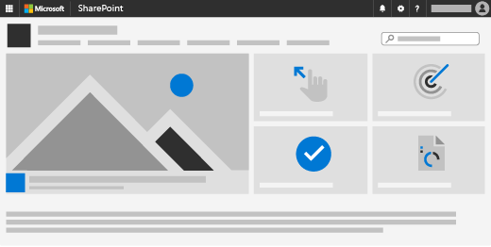
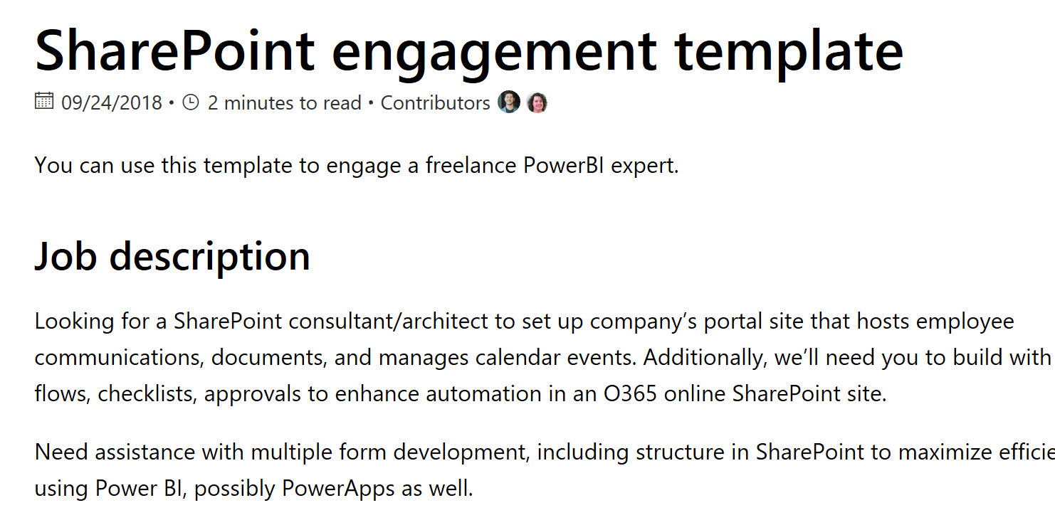
Internal communication
Employees need a place where they can learn how the program works, fulfill their training requirements, and review best practices for working with freelancers.
Tools
Templates
Best practices
A SharePoint communication site that provides a repository for program documentation
A curated talent pool of SharePoint experts to help enterprises customize their communication sites
A SharePoint communication site template that includes an FAQ seeded with the top questions from enterprise employees
A prepopulated hiring template to help employees start engaging with freelancers
As employees begin thinking about working with freelancers, we've found that it's important to provide access to as much information as possible, and to make onboarding clear and simple. Learn more

Slide 8
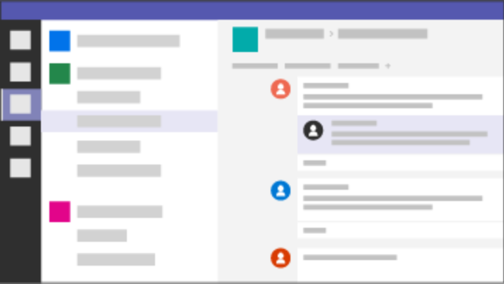

Team-wide collaboration
Enterprise freelance projects require team members to work together on multiple files, manage varied tasks, and communicate across time zones.
Tools
Best practices
Public and private teams for members to engage in discussion
One place to track progress and align each team member's workflow through project management tools like Microsoft Project
One place to store shared files and retrieve them through intelligent search
The ability for external users worldwide to collaborate in all aspects of freelance projects through Microsoft teams free guest access
As employees start working with freelancers, we've found that streamlined collaboration becomes critical to operating effectively. Learn more

Slide 9
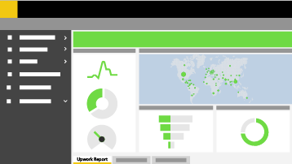
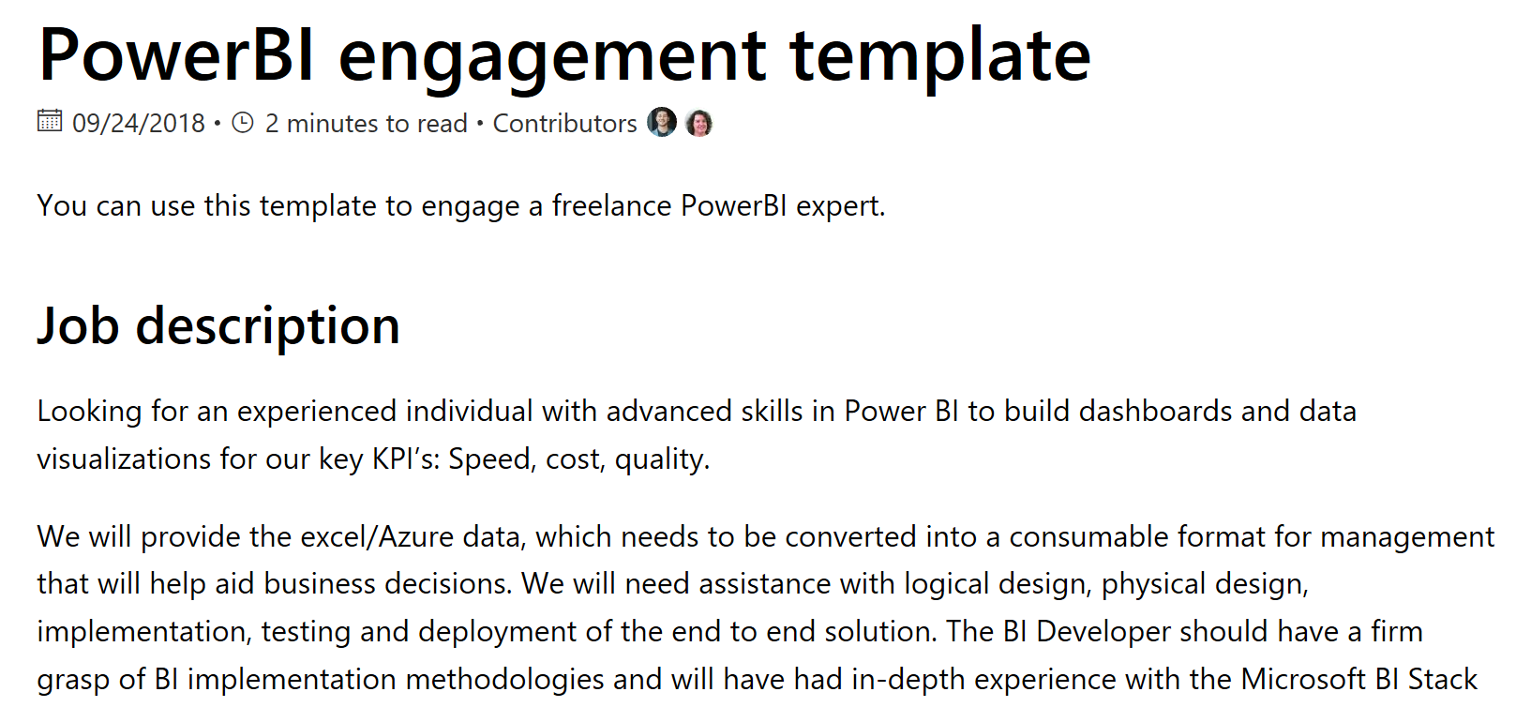
Data analytics
Freelance program administrators need to capture, track, and communicate program metrics, compare freelance KPIs to other staffing options, and identify groups that leverage the program most effectively.
Tools
Templates
Best practices
Power BI to share data visualizations, insights, and reports with others
A Power BI connector to pull data from disparate sources into dashboards
A curated talent pool of Power BI experts to help enterprises customize their dashboards
A Power BI template with sample visualizations
A prepopulated hiring template to help employees start engaging with freelancers
As a data-driven enterprise, we've found that measuring the effectiveness of our freelance program is critical to program growth and health. Learn more

Slide 10
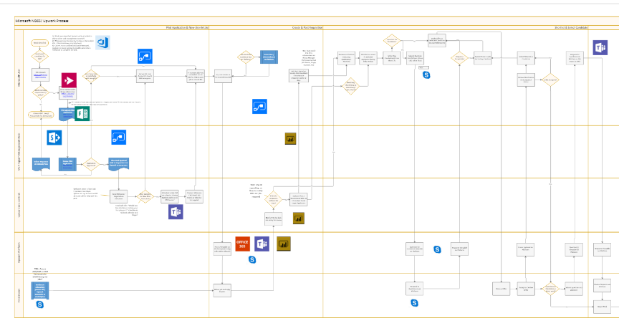
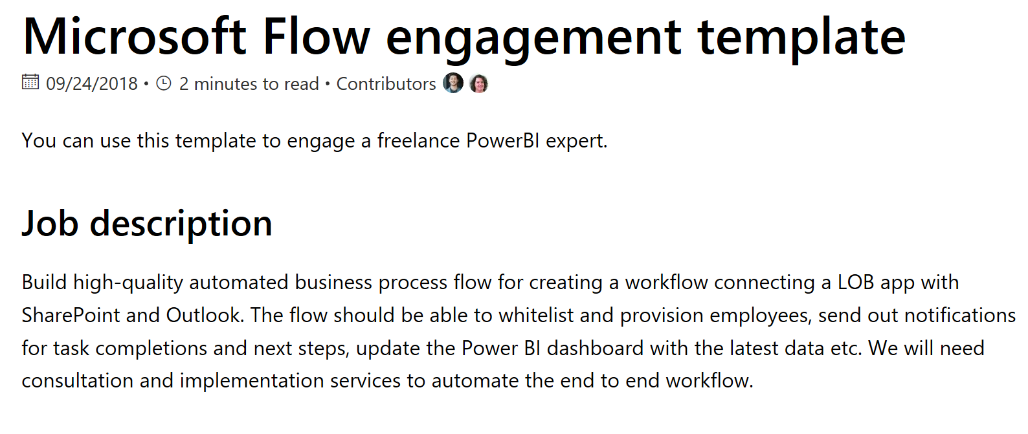
Workflow automation
Freelance program managers need to reduce manual completion of repetitive tasks by creating automatic, repeatable processes.
Tools
Templates
Best practices
Microsoft Flow to create automated workflows, send notifications, synchronize files, and collect data
Infographics that show how to use Flow within an enterprise freelance program
A curated talent pool of experts to help customize flow scenarios
A prepopulated hiring template to help employees start engaging with freelancers
As our enterprise freelance program grows, we've learned that freelance program management is a high-demand, multi-faceted role. Automating some aspects of the work has been critical to sustaining operations. Learn more

Slide 11

Our journey
It’s paid off. To date, we’ve:
Completed over 1,800 freelance projects
Reduced time to engage from 20 to 5.4 days
Achieved 4.9/5 freelancer star rating
More importantly, we have seen firsthand how employees can evolve from having a genuine fear of a freelancer model to recognizing how much more productive and enjoyable their work is when they work with freelancers.

Slide 12
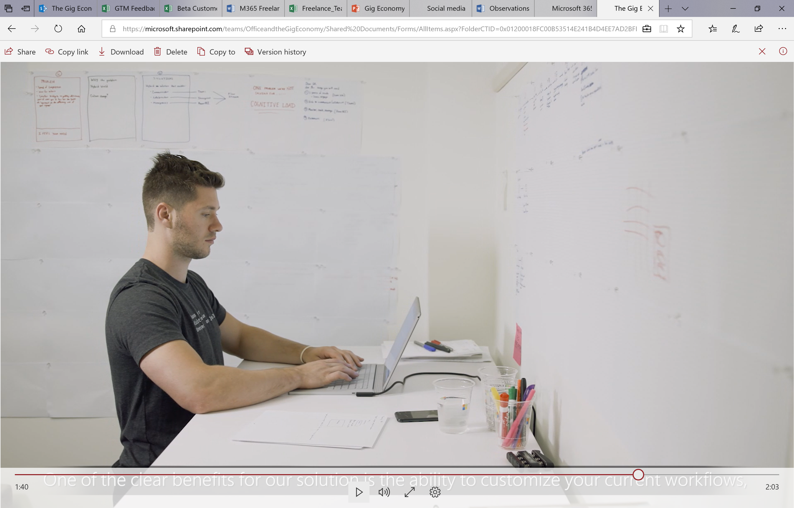
What we learned
Getting to this point was not easy—we had to internally transform ourselves, and we needed to build an infrastructure that could support the complexities of an enterprise freelance program.
This led us to develop the Microsoft 365 Freelance Toolkit, combining our own leading enterprise productivity apps with curated tools, templates, and best practices to address the specific needs of enterprise freelance programs.

Slide 13
Next steps
Ready to get started?
Microsoft 365 Freelance Toolkit is free with Microsoft 365 subscriptions—there are no additional costs if customers already have Teams, Flow, SharePoint and Power BI.
Learn more

Slide 14
Appendix

Slide 15
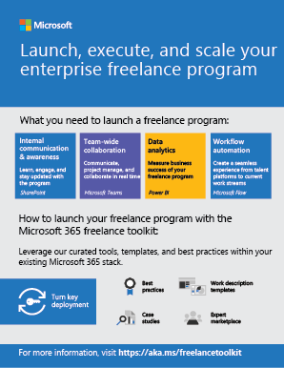
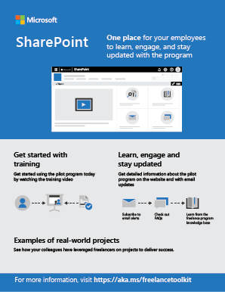
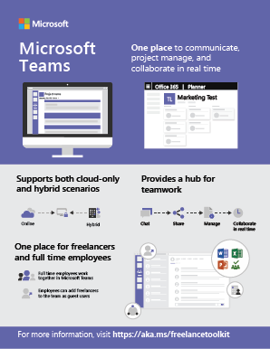
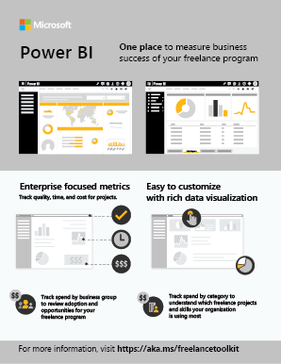
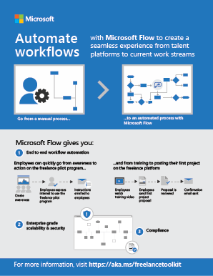
These infographics were designed to help you drive stakeholder discussion around how your existing investments in Microsoft 365 can help support an enterprise freelance program.
Learn more

Slide 16
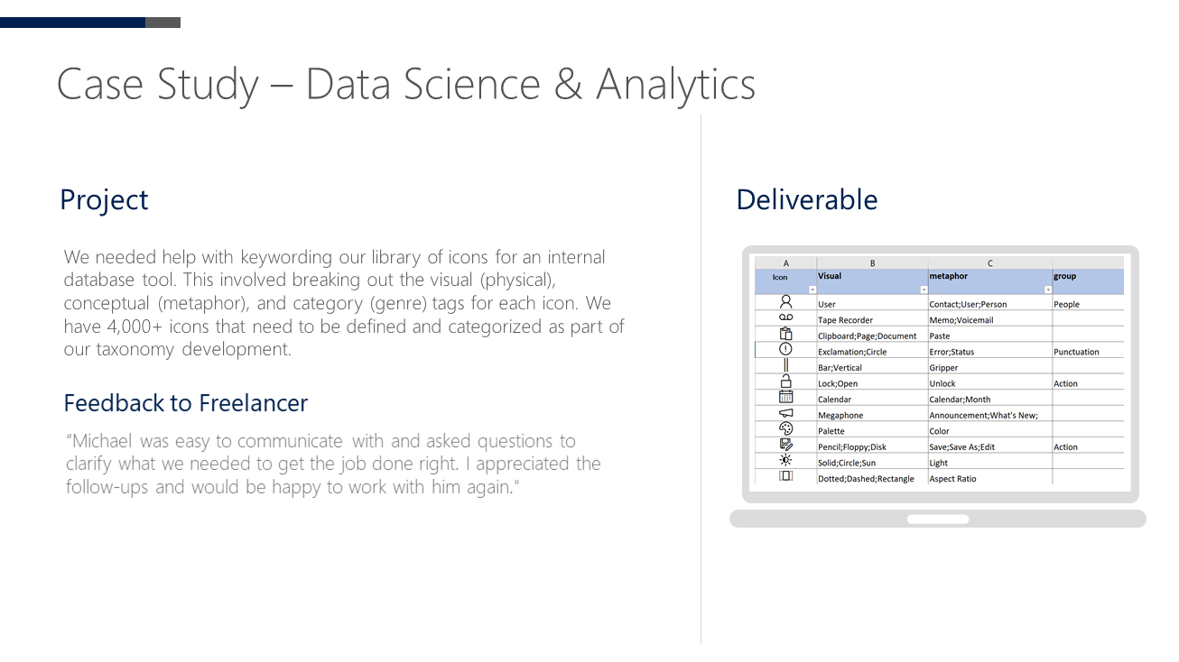
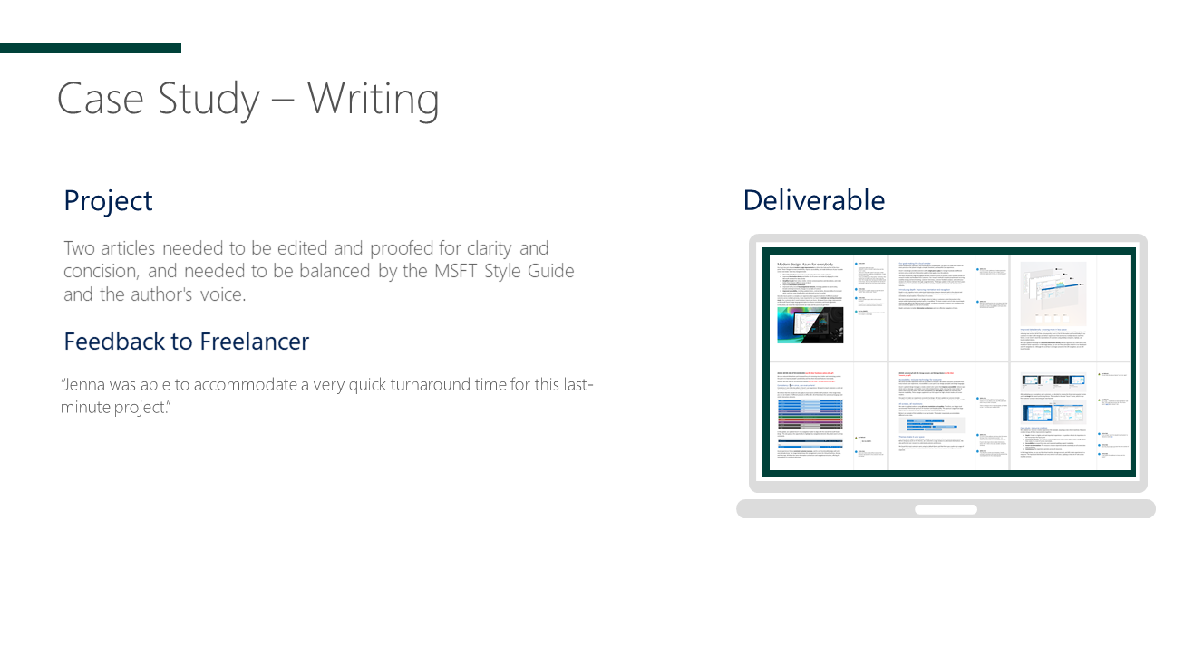
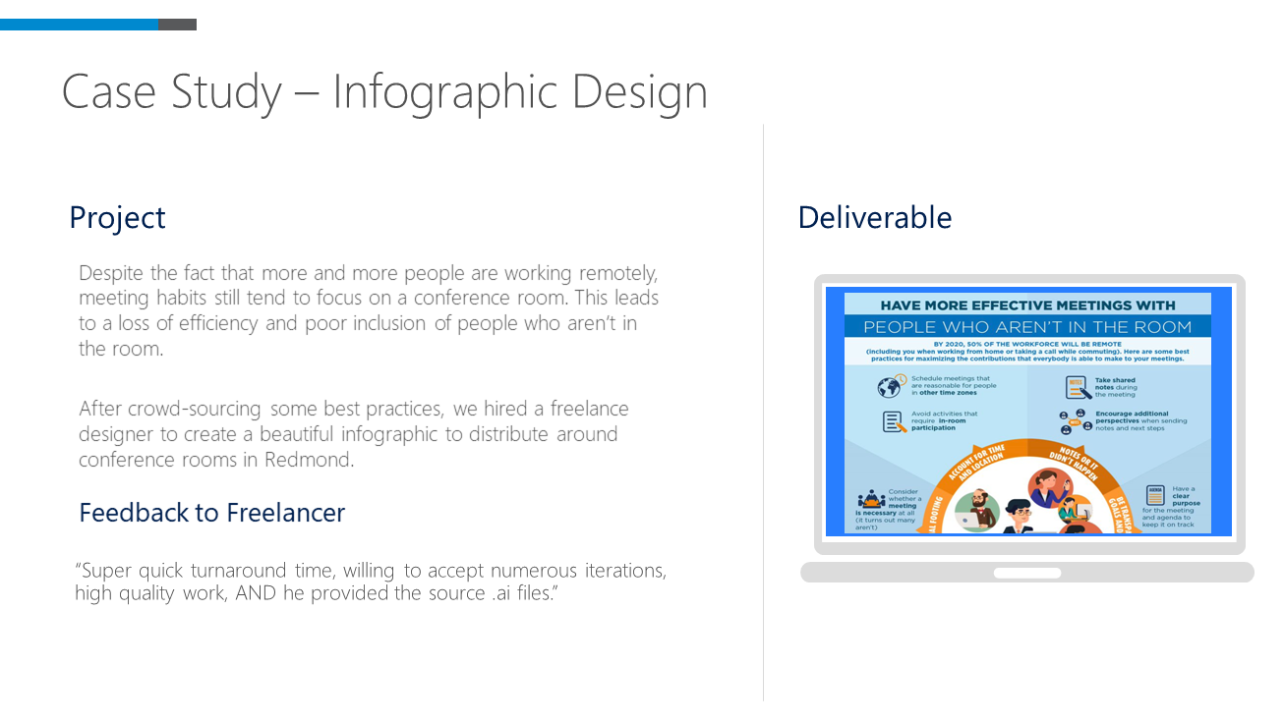
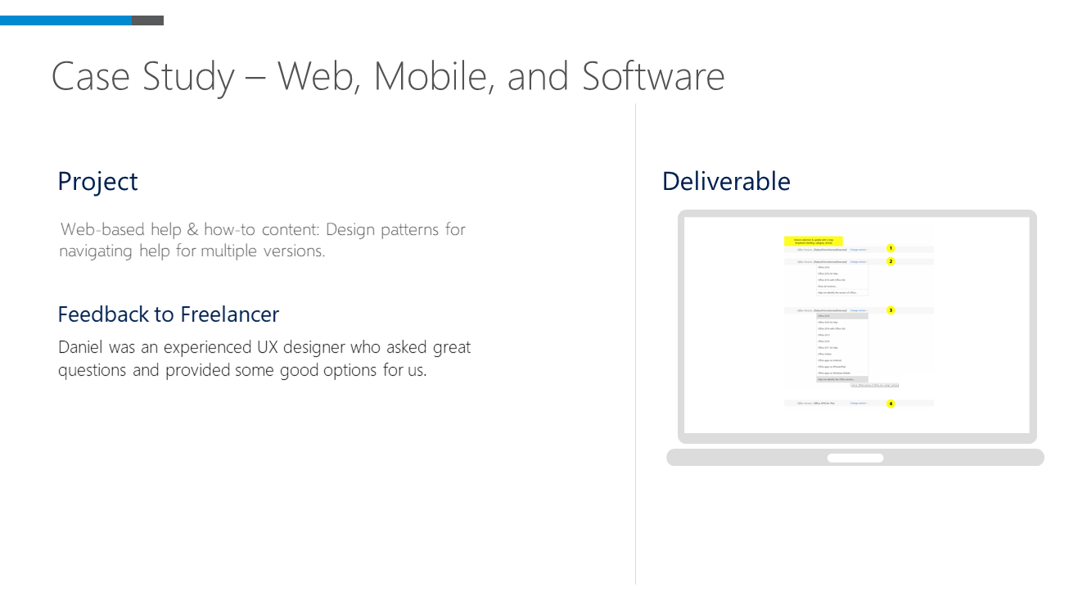
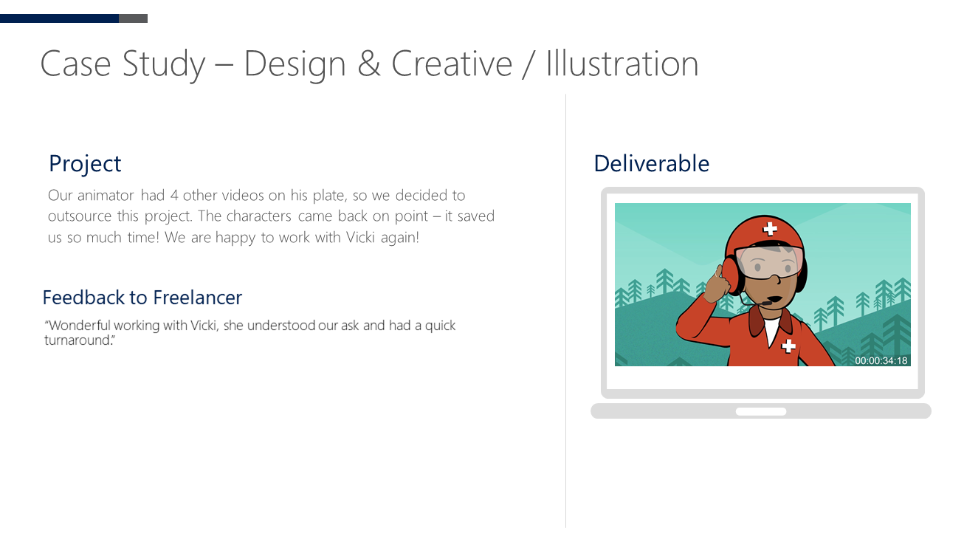
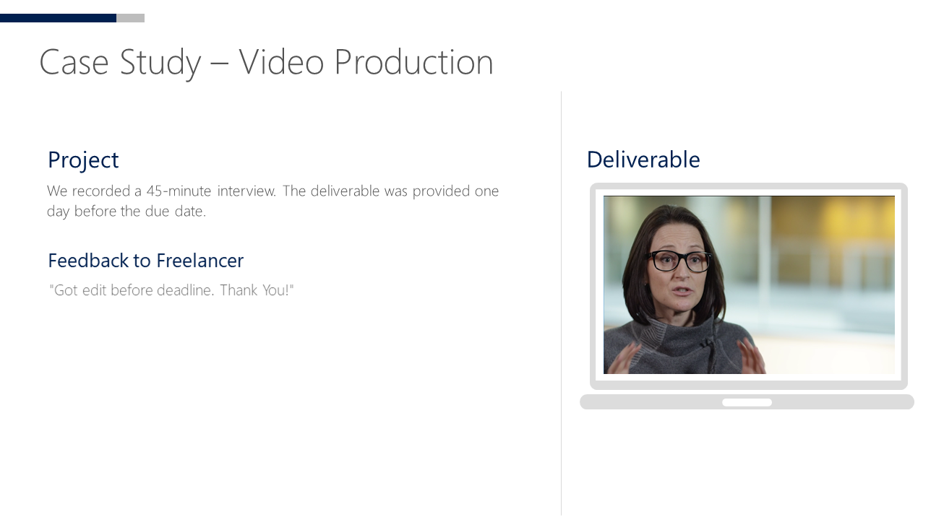
These case studies are a sample of projects you can use with freelance. With the Toolkit, you will receive the full list.
Learn more

Slide 17
Thank you

